Slide 1

TICKETING APPLICATION FOR DEFECT MANAGEMENT

Slide 2

TEAM MEMBERS
Mittapalli Pavani
Pala Uma
Banu Sahthya Janga
Sukanya R
Sowjanya Pati

Slide 3
TABLE OF CONTENTS
Understanding The Problem Statement
Planning and Design
3. Coding and Execution
4. Code Testing
Challenges Faced

Slide 4
INTRODUCTION
A major test objective is to identify defects.
Defects are basically considered as destructive in all software development stages. Any unexpected things that occur in software stages are defective in that particular software.

Slide 5
Introduction To The Problem Statement
Understanding the problem statement
Defects are assigned to programmers depending on functional area.
Information available in multiple files, are need to passed to the applications as command line arguments.
Format the defect description files.
Programmers information is available in “employees.txt”file.

Slide 6
High Level Design
Invalid Defects
Write Invalid
Defects
Is Defect valid
Start
Defect Files
Read Defects
Programmers
Details
Read Programmers
Details
Programmers Data
Defect Details
Yes
Is there a programmer for the given Defect?
Unassigned Defects
Write Unassigned Defects
No
Printing the Details of Employee and Assigned Defects
Stop
Individual Employee File
Save Employee Data on File
Update Status of Defect Files

Slide 7
Low Level Design

Slide 8
Program Flow
Input files
main.c
getdefect.c
assign.c
Output files

Slide 9
main.c
main()
Input Defect ﬁles are taken as command line arguments and also validates them.
Separate threads are created for each input ﬁles and these ﬁles are passed to getDefect() Function.
It calls getEmployee() function to fetch data from Employee Database.
Finally it waits for all threads to complete their work.

Slide 10
GetDefect ()
It reads defects from the input ﬁle
calls checkvalidity if true call validDefect() Else call invaliddefect()
It calls assignEmployee() for valid defect
.

Slide 11
assign.c
1. assignEmployee()
It loops through all defects and checks their status.
If status is open then it calls searchProgrammer() Function.
Defects with any other status are ignored.

Slide 12
2.SearchProgrammer()
Now for each defect passed, it searches for programmer in the array.
Search Criteria:
Functional Area of Defect shall match with Expertise of Programmer.
If there is a match, the defect is assigned to the programmer and createEmployeeFile() Function is called.
If no programmer could be found then uassignedDefect() Function is called for that defect.

Slide 13
CODING AND EXECUTION

Slide 14
FILES
TESTING
defectID : description : moduleName : Functional Area: date : status : type
1. F001:Column values in BOM reports are incorrect:Aircraft design:BOM reports:21/08/2022:open:fatal
2. F002:Unit prices are not shown while preparing invoice:Invoices:Display products:23/04/2022:close:fatal
3. N001:BOM report columns not aligned properly:Aircraft design:BOM reports:21/08/2022:open:niceToHave
Defect.txt

Slide 15
EmployeeID : Name : Business Unit : Expertise : Designation
1. A123:Suresh Panchal:UK Telecom:BOM report:Principal engineer
2. D012:J K Laxmi:Finacle Systems:Display products:Junior programmer
3. C015:Sandeep Khaire:UK Telecom:Manage customers:Senior programmer
Employee.txt

Slide 16
DIFFERENT TYPES OF TEST CASES
➔ Less than or More than Actual Defect Attributes
➔ Less than or More than Actual Employee Attributes
➔ No Programmer is Found for Defect
➔ More than one Programmer is Found
➔ File is Empty or not Opening or Invalid file type
➔ Wrong Format of Defects or Employee in File
➔ Multiple Defect.txt Files
➔ Defect Status Close/Open Or Something else
➔ Defect With same Defect IDs
➔ Date Format is Wrong
➔ Space ‘ ‘ is Considered as Character EX:- : BOM report :--

Slide 17
INTEGRATIONTESTING OUTPUT

Slide 18
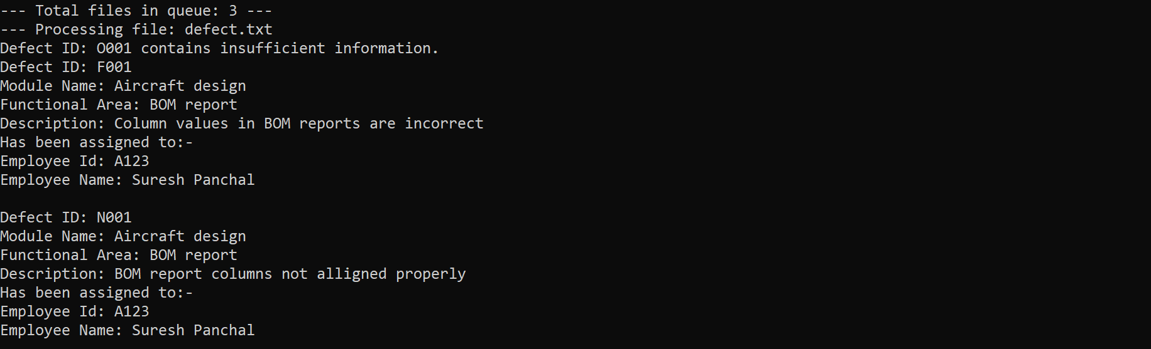
Testing output - 1

Slide 19
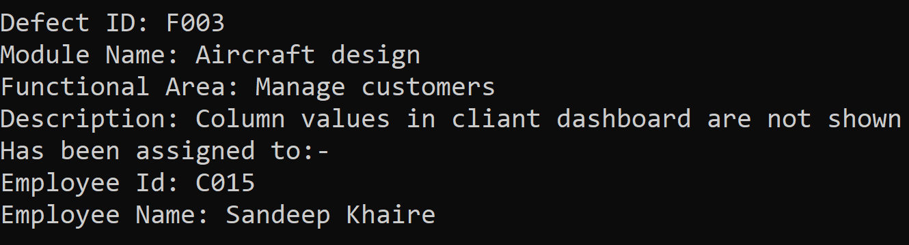
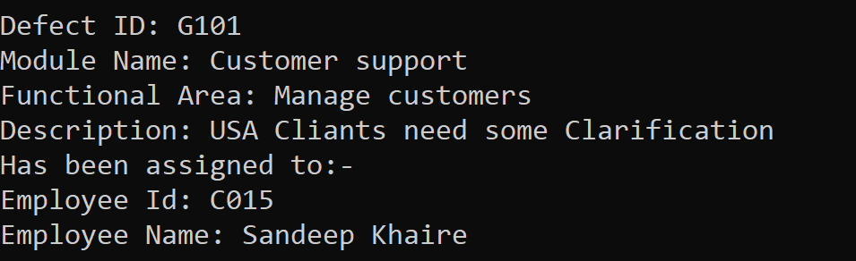
Testing output - 2

Slide 20
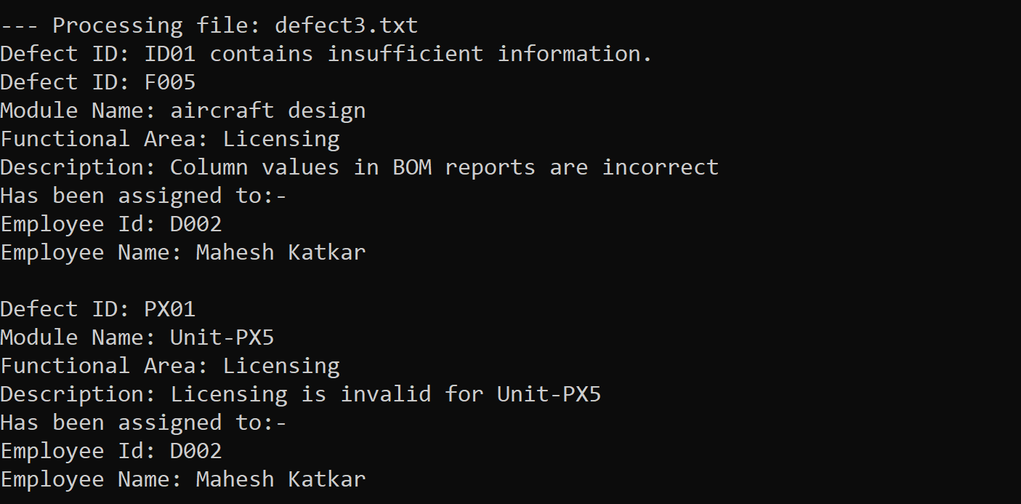
Testing output - 3

Slide 21
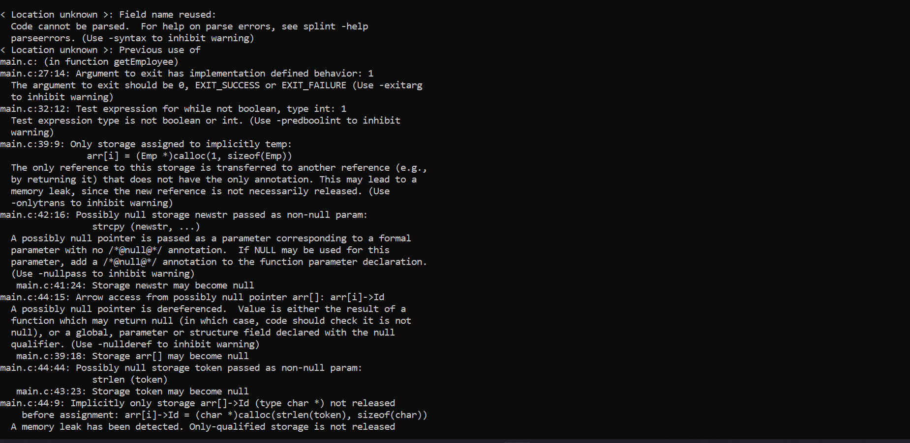
Splint

Slide 22
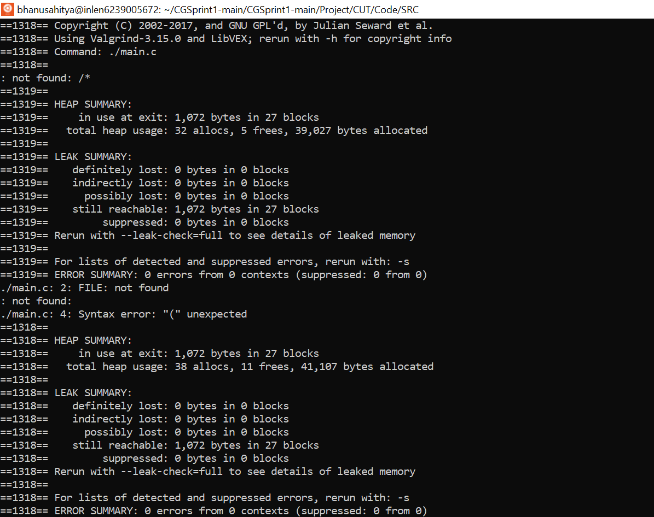
Valgrind

Slide 23
Latest Defect Management Tools
Bugzilla
BMC Remedy

Slide 24
OVERVIEW
This project aims to develop a Defect Programmer Assignments application where clients of a Software Development company report defects in software they purchased.
These defects are assigned to programmers depending on the functional area they are handling

Slide 25
OBSTACLES
Challenges faced
To decide which data structure would be best for our project
Checking validity of the employee
Finding defect in the file from the program

Slide 26
Github Link
https://github.com/pavanimittapalli/TICKETING-APPLICATION-FOR-DEFECT-MANAGEMENT-PROCESS

Slide 27


